Slide 1



Graph1
View in Power BI
Last data refresh:
4/10/2024 11:16:48 AM UTC
Downloaded at:
4/10/2024 12:10:18 PM UTC

Slide 2
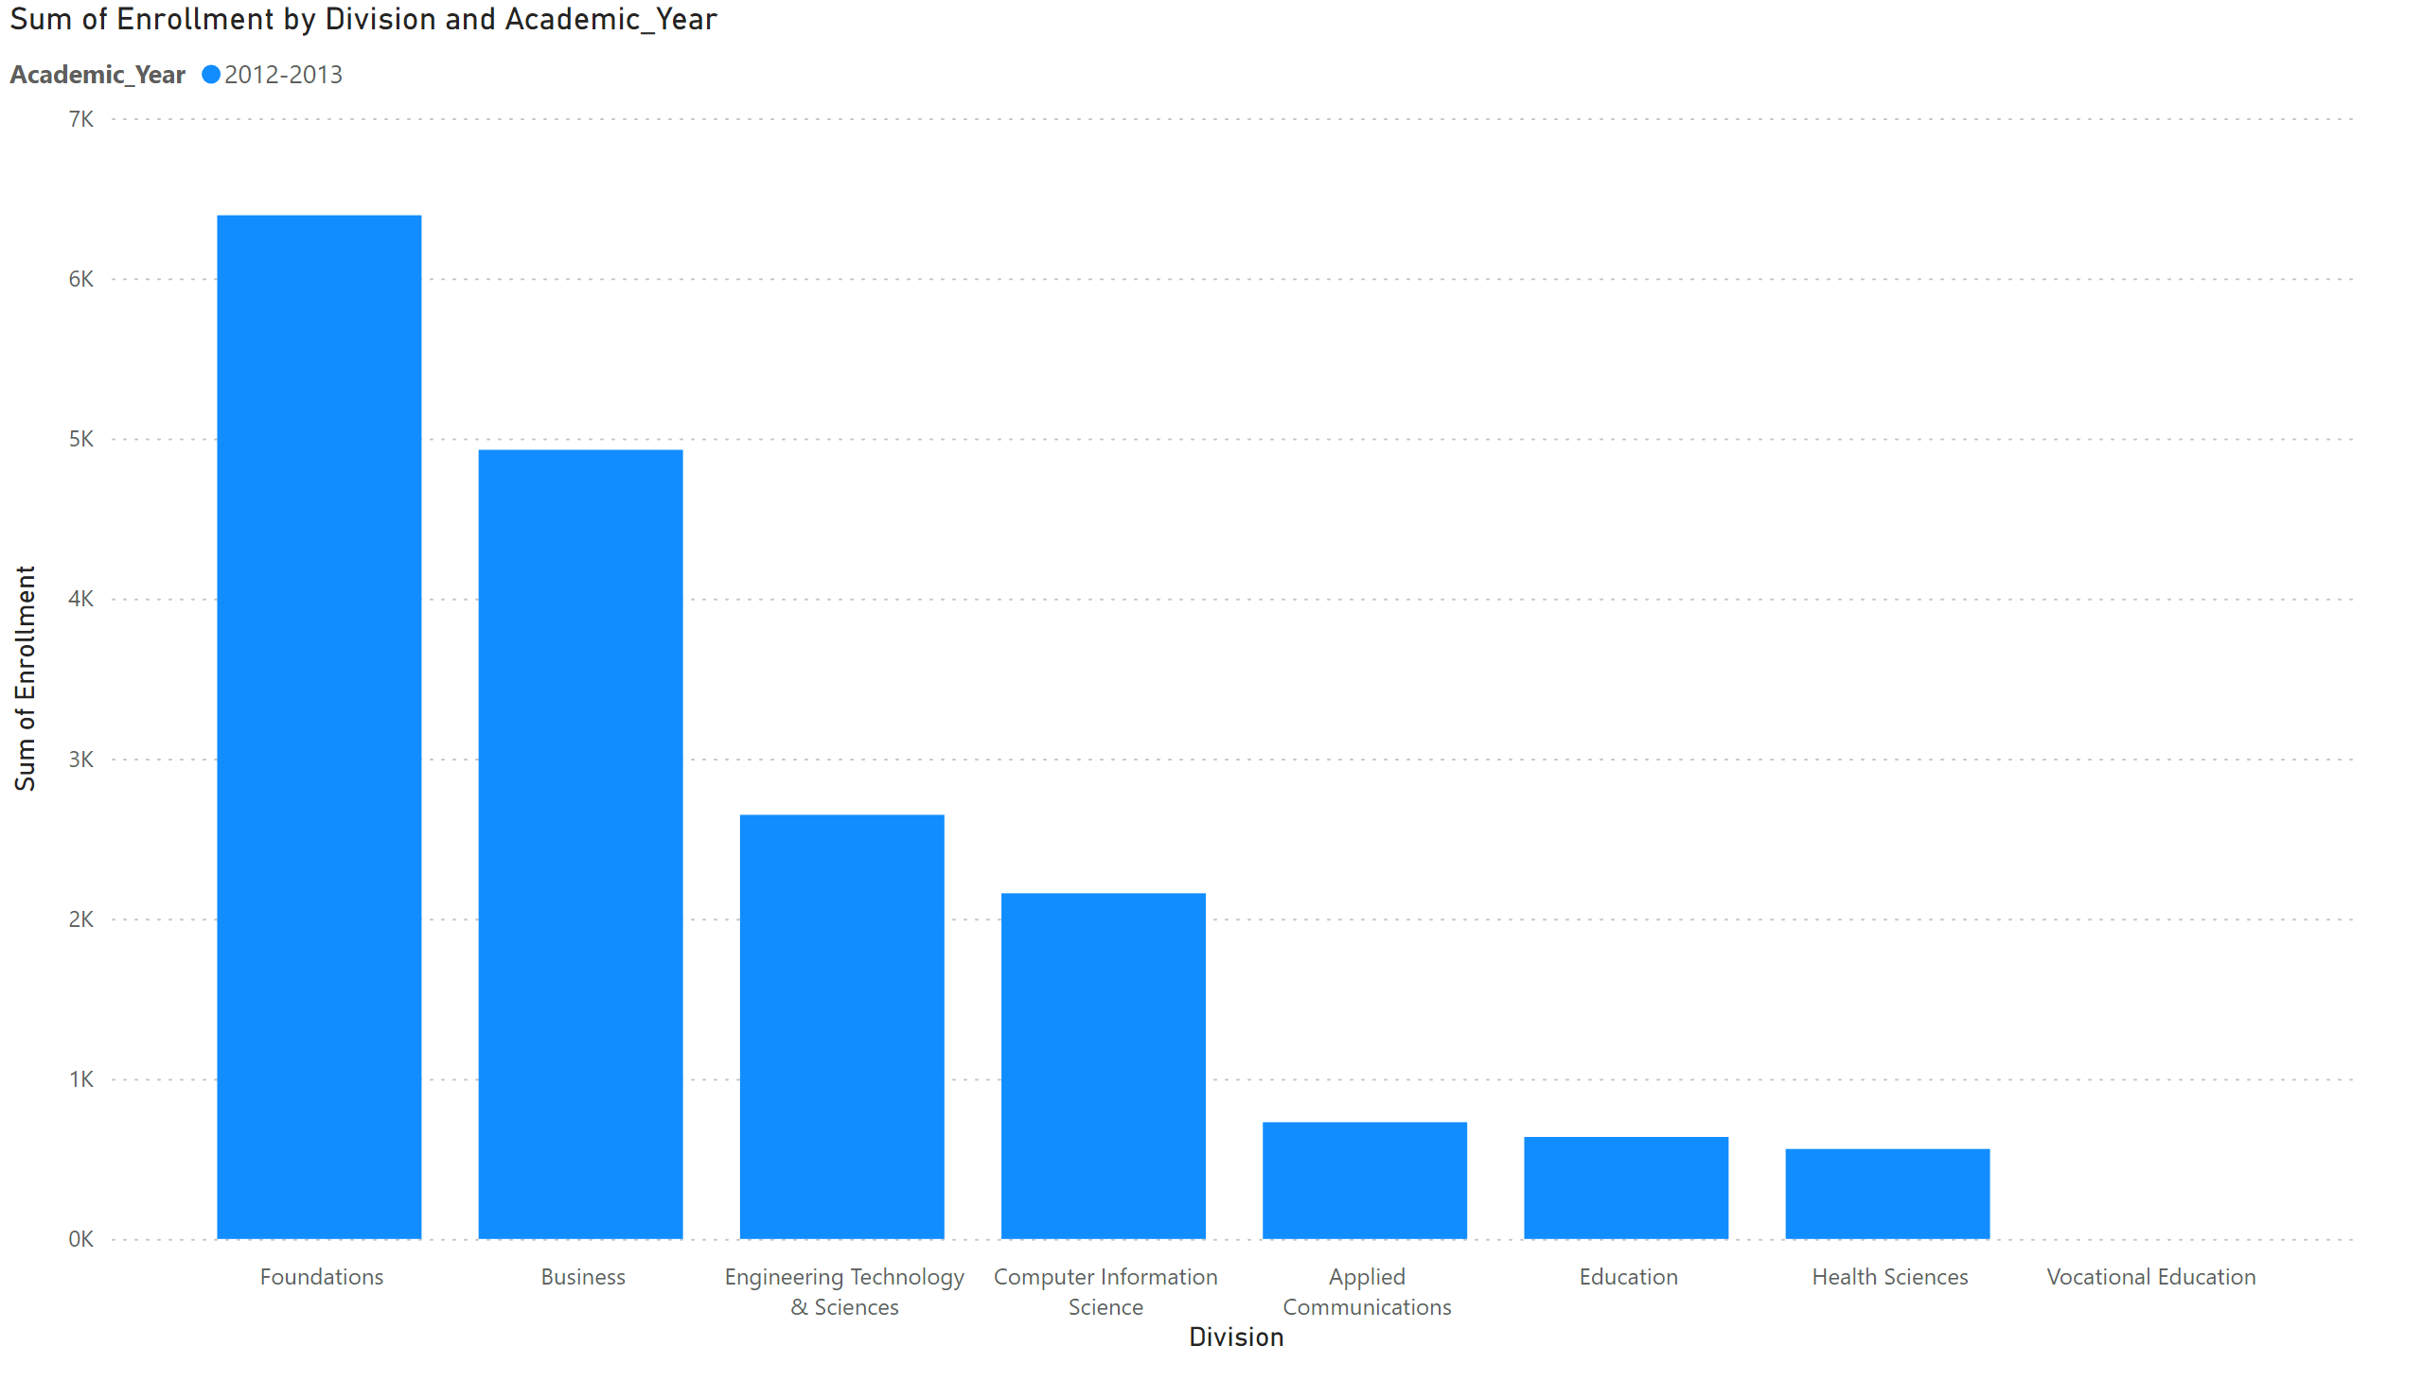
Page 1
Notes:
hundredPercentStackedBarChart
No alt text provided
columnChart
No alt text provided

